Slide 1

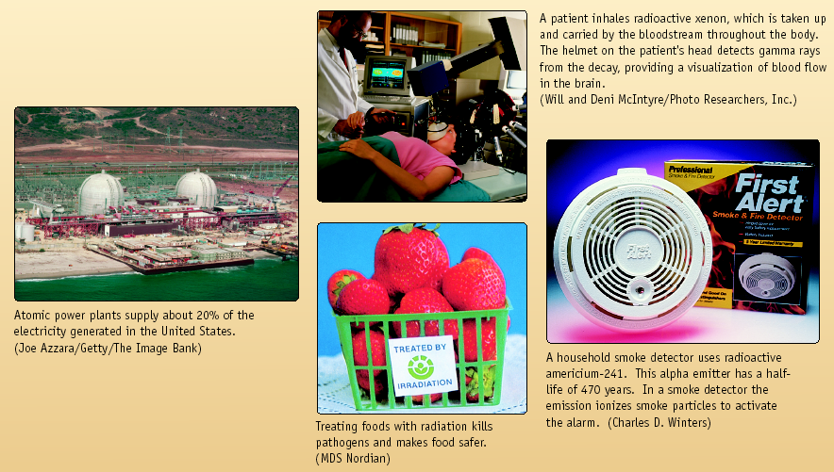
Nuclear Chemistry
Chemistry I – Chapter 25
Chemistry I Honors – Chapter 19
ICP – Chapter 18
SAVE PAPER AND INK!!! When you print out the notes on PowerPoint, print "Handouts" instead of "Slides" in the print setup. Also, turn off the backgrounds (Tools>Options>Print>UNcheck "Background Printing")!

Slide 2
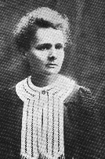
Radioactivity
One of the pieces of evidence for the fact that atoms are made of smaller particles came from the work of ________ (1876-1934).
She discovered ________, the spontaneous disintegration of some elements into smaller pieces.

Slide 3
Nuclear Reactions vs. Normal Chemical Changes
Nuclear reactions involve the nucleus
The nucleus opens, and protons and neutrons are rearranged
The opening of the nucleus releases a tremendous amount of energy that holds the nucleus together – called binding energy
“Normal” Chemical Reactions involve electrons, not protons and neutrons

Slide 4
Mass Defect
Some of the mass can be converted into energy
Shown by a very famous equation!
E=mc²
Energy
Mass
Speed of light

Slide 5
Types of Radiation
Alpha (ά) – a positively charged helium isotope - we usually ignore the charge because it involves electrons, not protons and neutrons
Beta (β) – an electron
Gamma (γ) – pure energy; called a ray rather than a particle

Slide 6
Other Nuclear Particles
Neutron
Positron – a positive electron
Proton – usually referred to as hydrogen-1
Any other elemental isotope

Slide 7
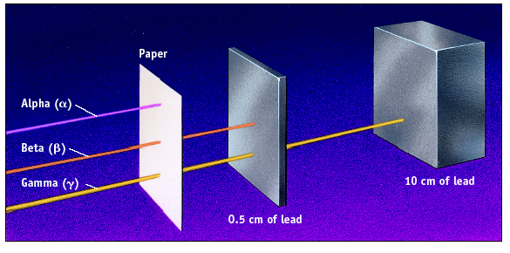
Penetrating Ability

Slide 8
Balancing Nuclear Reactions
In the reactants (starting materials – on the left side of an equation) and products (final products – on the right side of an equation)
Atomic numbers must balance
and
Mass numbers must balance
Use a particle or isotope to fill in the missing protons and neutrons

Slide 9
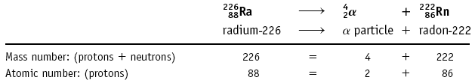
Nuclear Reactions
Alpha emission
Note that mass number (A) goes down by 4 and atomic number (Z) goes down by 2.
Nucleons (nuclear particles… protons and neutrons) are rearranged but conserved

Slide 10
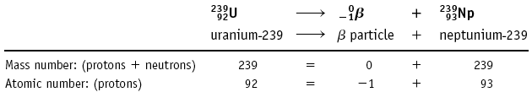
Nuclear Reactions
Beta emission
Note that mass number (A) is unchanged and atomic number (Z) goes up by 1.

Slide 11
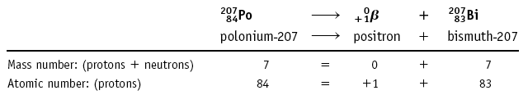
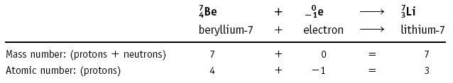
Other Types of Nuclear Reactions
Positron (⁰₊₁β): a positive electron
207
207
Electron capture: the capture of an electron

Slide 12
Learning Check
What radioactive isotope is produced in the following bombardment of boron?
¹⁰B + ⁴He ? + ¹n
5 2 0

Slide 13
Write Nuclear Equations!
Write the nuclear equation for the beta emitter Co-60.

Slide 14
Artificial Nuclear Reactions
New elements or new isotopes of known elements are produced by bombarding an atom with a subatomic particle such as a proton or neutron -- or even a much heavier particle such as ⁴He and ¹¹B.
Reactions using neutrons are called
γ reactions because a γ ray is usually emitted.
Radioisotopes used in medicine are often made by γ reactions.

Slide 15
Artificial Nuclear Reactions
Example of a γ reaction is production of radioactive ³¹P for use in studies of P uptake in the body.
³¹₁₅P + ¹₀n ---> ³²₁₅P + γ

Slide 16
Transuranium Elements
Elements beyond 92 (transuranium) made starting with an γ reaction
²³⁸₉₂U + ¹₀n ---> ²³⁹₉₂U + γ
²³⁹₉₂U ---> ²³⁹₉₃Np + ⁰₋₁β
²³⁹₉₃Np ---> ²³⁹₉₄Pu + ⁰₋₁β

Slide 17
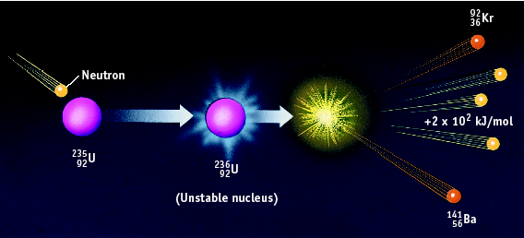
Nuclear Fission

Slide 18
Nuclear Fission
Fission is the splitting of atoms
These are usually very large, so that they are not as stable
Fission chain has three general steps:
1. Initiation. Reaction of a single atom starts the chain (e.g., ²³⁵U + neutron)
2. Propagation. ²³⁶U fission releases neutrons that initiate other fissions
3. ___________ .

Slide 19
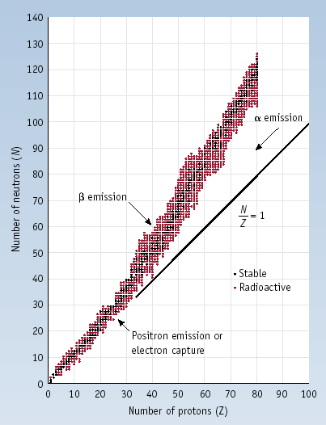
Stability of Nuclei
Out of > 300 stable isotopes:
N
Even
Odd
Z
Even
157
52
³¹₁₅P
Odd
50
5
¹⁹₉F
²₁H, ⁶₃Li, ¹⁰₅B, ¹⁴₇N, ¹⁸⁰₇₃Ta

Slide 20
Band of Stability and Radioactive Decay

Slide 21
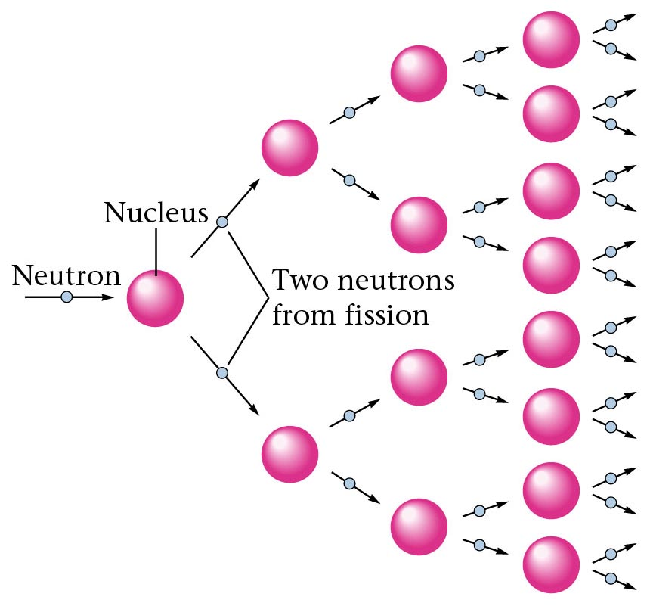
Representation of a fission process.

Slide 22
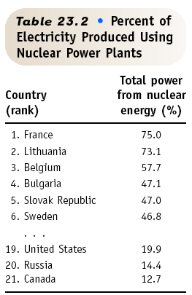
Nuclear Fission & POWER
Currently about 103 nuclear power plants in the U.S. and about 435 worldwide.
17% of the world’s energy comes from nuclear.

Slide 23
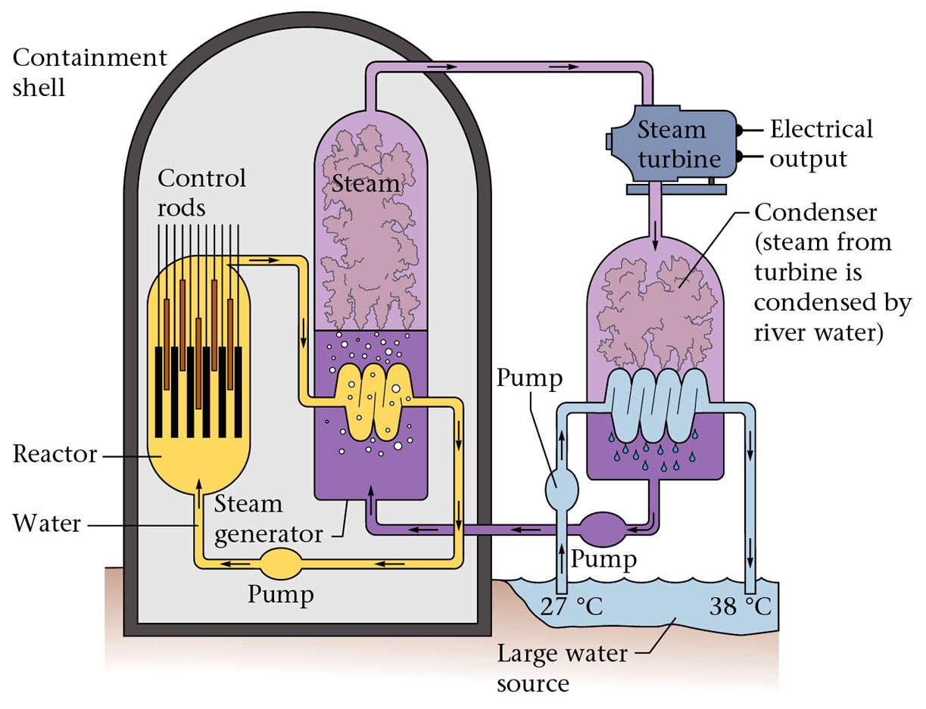
Figure 19.6: Diagram of a nuclear power plant.

Slide 24
Nuclear Fusion
Fusion
small nuclei combine
²H + ³H ⁴He + ¹n +
1 1 2 0
Occurs in the sun and other stars
Energy

Slide 25
Nuclear Fusion
Fusion
Excessive heat can not be contained
Attempts at “cold” fusion have FAILED.
“Hot” fusion is difficult to contain

Slide 26
Half-Life
HALF-LIFE is the time that it takes for 1/2 a sample to decompose.
The rate of a nuclear transformation depends only on the “reactant” concentration.

Slide 27
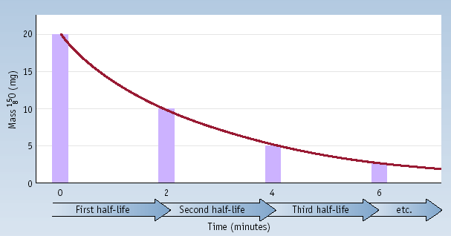
Half-Life
Decay of 20.0 mg of ¹⁵O. What remains after 3 half-lives? After 5 half-lives?

Slide 28
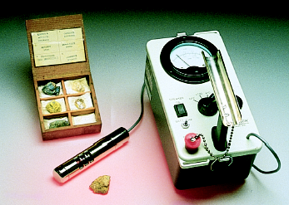
Kinetics of Radioactive Decay
For each duration (half-life), one half of the substance decomposes.
For example: Ra-234 has a half-life of 3.6 days
If you start with 50 grams of Ra-234
After 3.6 days > 25 grams
After 7.2 days > 12.5 grams
After 10.8 days > 6.25 grams

Slide 29
Learning Check!
The half life of I-123 is 13 hr. How much of a 64 mg sample of I-123 is left after 39 hours?

Slide 30
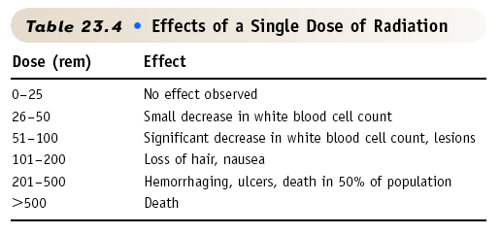
Effects of Radiation

Slide 31
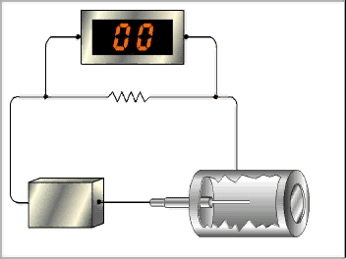
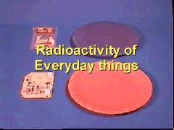
Geiger Counter
Used to detect radioactive substances

Slide 32
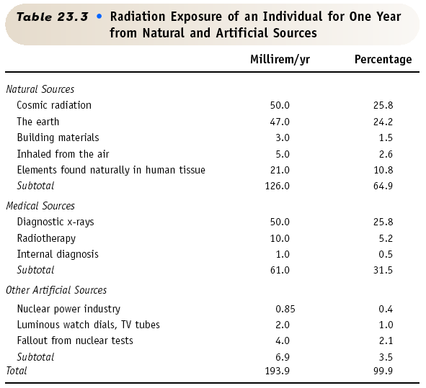

Slide 33
Radiocarbon Dating
Radioactive C-14 is formed in the upper atmosphere by nuclear reactions initiated by neutrons in cosmic radiation
¹⁴N + ¹_{o}n ---> ¹⁴C + ¹H
The C-14 is oxidized to CO₂, which circulates through the biosphere.
When a plant dies, the C-14 is not replenished.
But the C-14 continues to decay with t_{1/2} = 5730 years.
Activity of a sample can be used to date the sample.

Slide 34
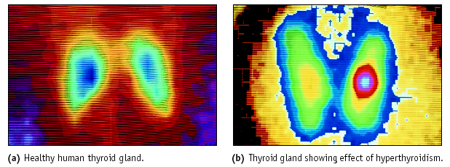
Nuclear Medicine: Imaging
Thyroid imaging using Tc-99m

Slide 35
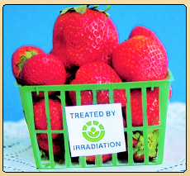
Food Irradiation
Food can be irradiated with γ rays from ⁶⁰Co or ¹³⁷Cs.
Irradiated milk has a shelf life of 3 mo. without refrigeration.
USDA has approved irradiation of meats and eggs.

